Slide 1
Analysis of 2016-17 NHL Player Data
Chris Benzen
Chris Gargano
Jack Weiland

Slide 2
AGENDA
Project Description
Data Collection & Validation
Data Analysis
Results

Slide 3
PROJECT DESCRIPTION

Slide 4
PROJECTION DESCRIPTION
Using a data set for the 2016-17 NHL Season, we will compare analyze a variety of different measures to identify interesting trends and unique data relationships.
We will have a particular focus on player salaries, and whether higher paid players are really worth their salaries.

Slide 5
DATA COLLECTION & VALIDATION

Slide 6
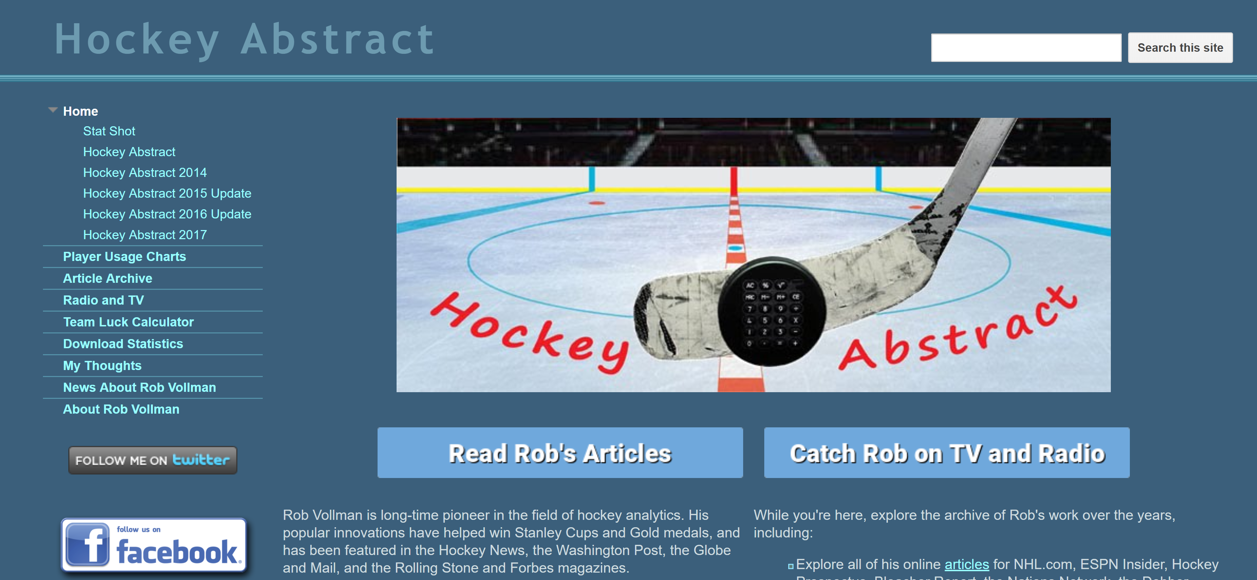
DATA COLLECTION & VALIDATION
We chose to focus on the 2016-2017 season, the last full NHL season
Data was collected from: http://www.hockeyabstract.com/
The source data was compiled from several different sources, including:
NHL.com, Corscia.com, Puckalytics.com, Hockey-reference.com, and more

Slide 7
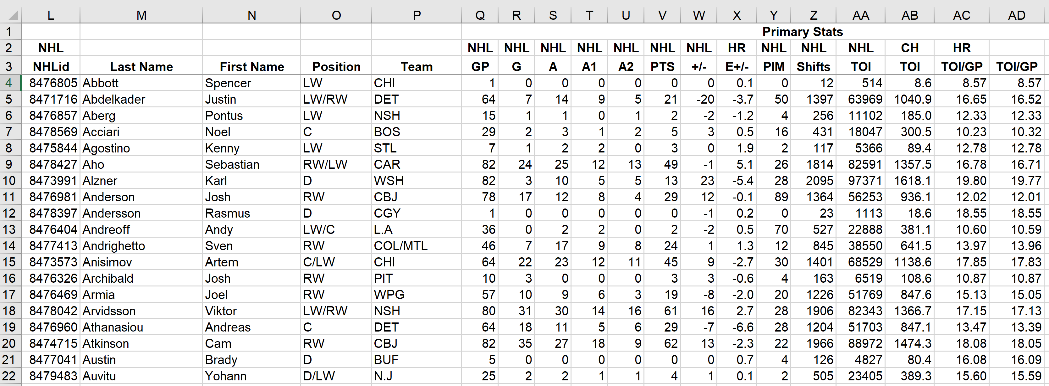
DATA COLLECTION & VALIDATION
Raw data came in Excel format
Number formats were cleaned and NULL values were removed in Excel

Slide 8
DATA COLLECTION & VALIDATION
For analysis involving player salary data, the data was subset to only include Unrestricted Free Agent (UFA) players
For analysis involving player’s nationality, countries with 5 or fewer active players was grouped into an “OTH” category

Slide 9
DATA ANALYSIS

Slide 10
DATA ANALYSIS
Boxplots:
Cap Hit by Nationality
Draft Round vs. Points Per Game
Bar Charts:
Goals and Shots by Shot Type
Scatterplots:
Cap Hit vs. Points Per Game
Goals For vs. Goals Against by Cap Hit
Donut Charts:
Cap Hit

Slide 11
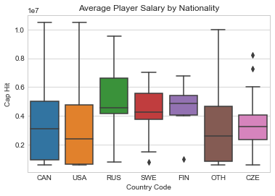
Cap Hit by Nationality
The distribution of cap hits appears very similar for Canadian and American players
The median cap hit for Russians, Finns and Swedes is noticeably higher than the cap hits
Russian players had the highest median cap hit in 2016-17, but this was heavily affected by top earners like Alex Ovechkin ($9.54M) and Evgeni Malkin ($9.5M)
Notes:
Break

Slide 12
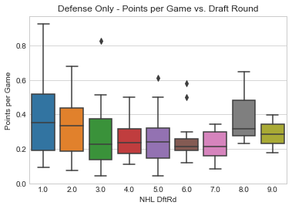
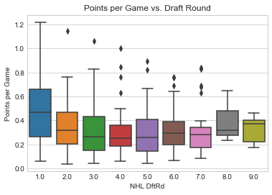
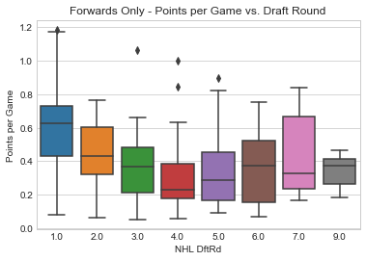
Draft Round vs. Points Per Game
Players drafted in the first round clearly have the highest median salary
After the first round, there are no noticeable difference in median salary

Slide 13
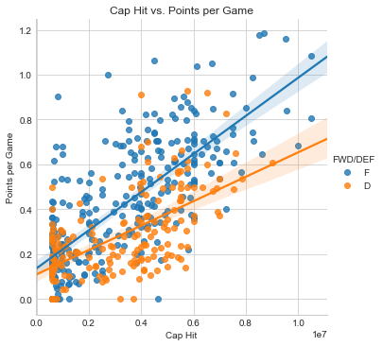
Cap Hit vs. Points per Game
There are clearly, positive linear trends between a player’s cap hit and their PPG.
As expected, forward have a higher average PPG than defensemen
There also appears to be less variability in the PPG vs. Cap Hit relationship among forwards compared to defensemen

Slide 14
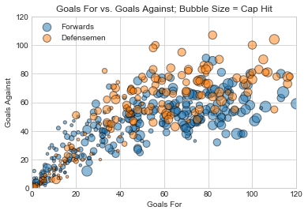
Goals For vs. Goals Against

Slide 15
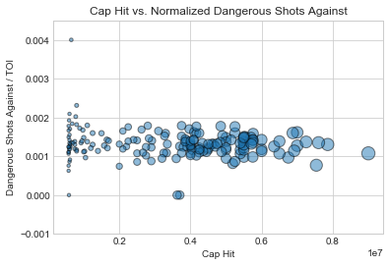
Dangerous Shots Against (D only)

Slide 16
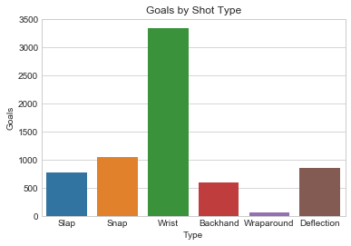
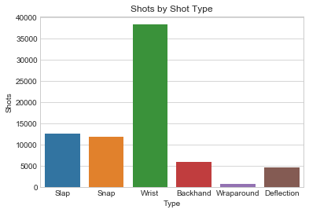
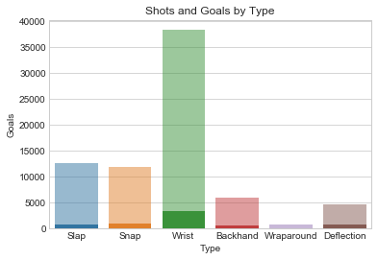
Goal & Shot Analysis

